Slide 1
Project Demo
Shakespearean Chatbot
Haseeb Muhammad (413927)
Muhammad Noshair Ghani (419161)
Ahmad Sarmad Ali (413977)

Slide 2
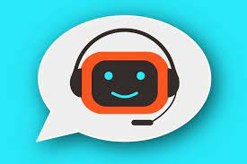
What is a chatbot?
Computer program: A chatbot is a software application or program.
Conversational interface: It interacts with users through text or voice conversations.
Simulates human conversation: It mimics natural language and conversation.
Automated responses: Provides predefined responses based on user input.
Tasks and queries: Can perform specific tasks or answer questions.

Slide 3
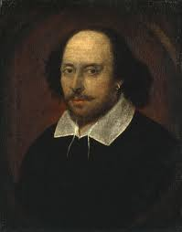
What is a Shakespearean chatbot?
A chatbot that mimics the famous writer William Shakespeare
Trained on a large dataset comprising Shakespeare’s works.
Able to respond to queries in the style of Shakespeare
Uses the vocabulary and writing style of Shakespeare

Slide 4
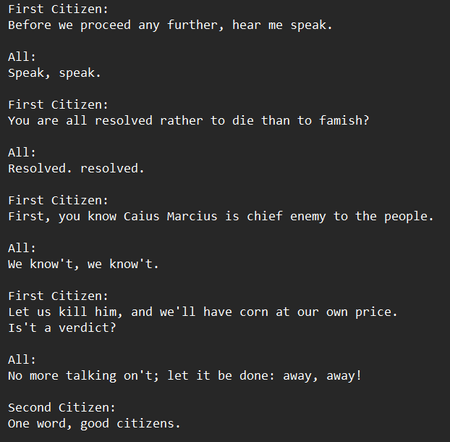
Dataset
Consists of dialogues written by Shakespeare
Contains vocabulary and grammar used by Shakespeare

Slide 5
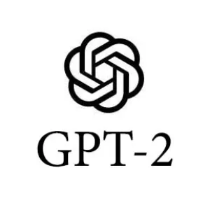
GPT-2
GPT-2 (Generative Pre-trained Transformer 2) is a powerful language model. Released in 2019, it employs a transformer architecture with 1.5 billion to 175 billion parameters, enabling it to generate human-like text and perform various natural language processing tasks with remarkable proficiency.

Slide 6
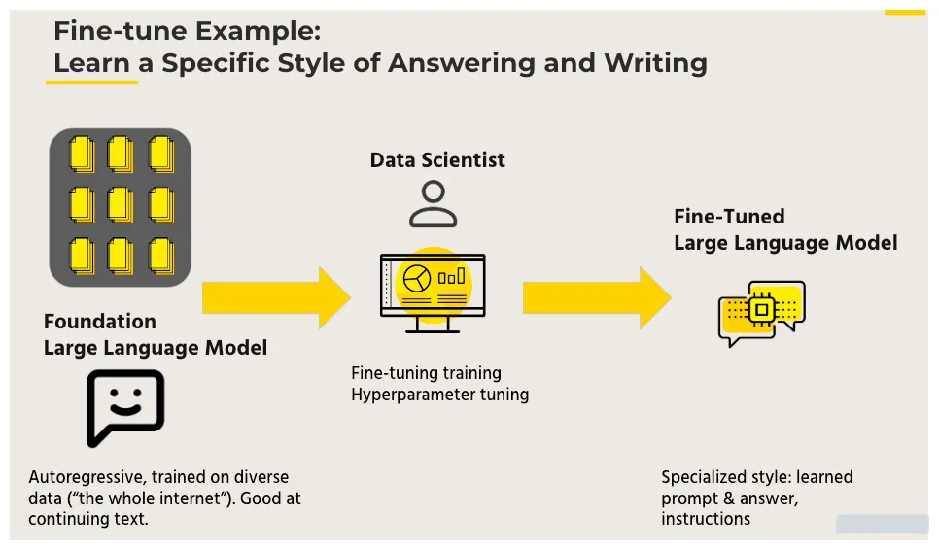
Fine-Tunning
Fine-tuning is a process in machine learning where a pre-trained model, like GPT-2, is further trained on specific data to adapt its knowledge to a particular task or domain. It optimizes the model's performance for specialized applications, enhancing its ability to generate contextually relevant and accurate outputs in a targeted context.

Slide 7
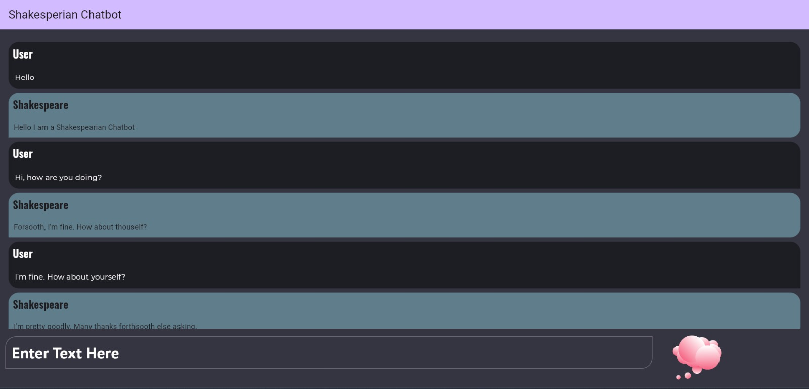

Slide 8
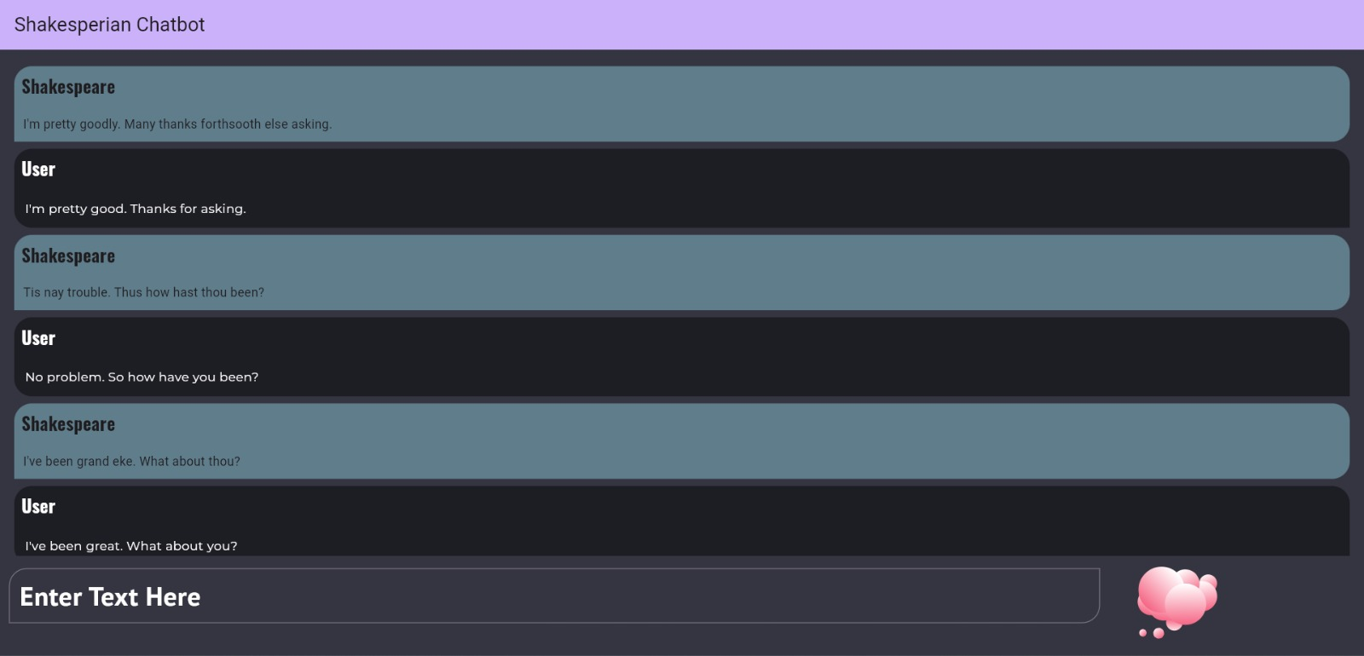

Slide 9
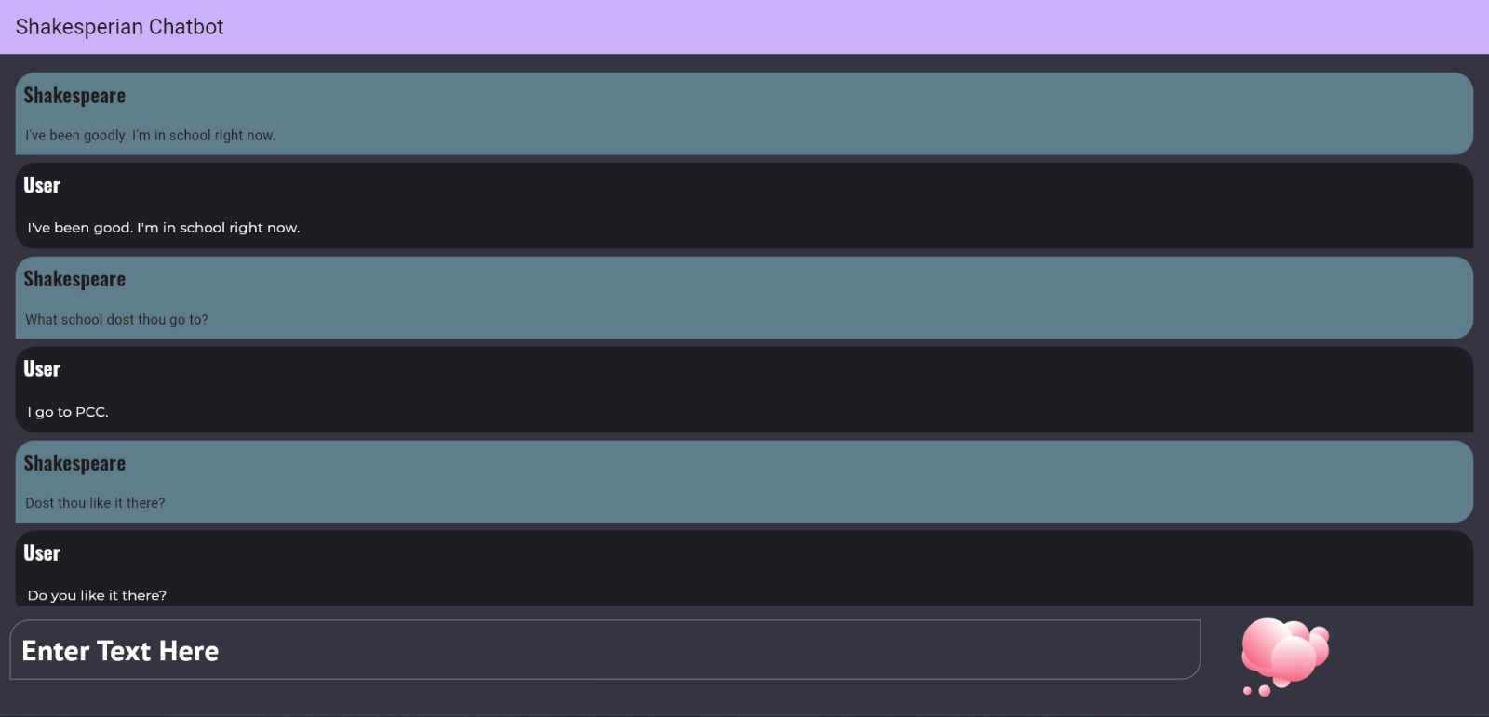

Slide 10
The END
GIT-HUB:
YOUTUBE:

